Slide 1
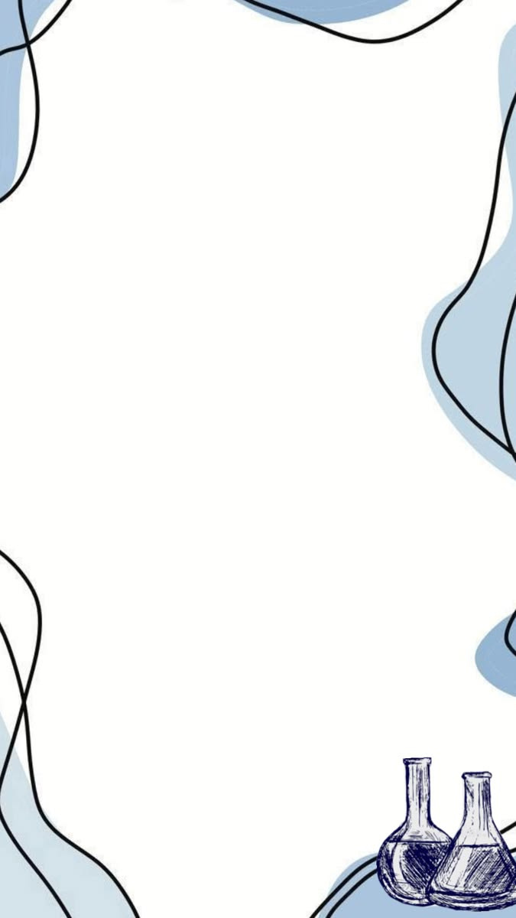
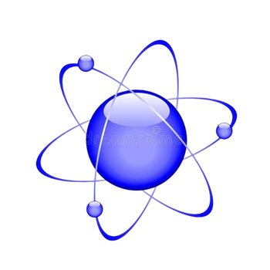
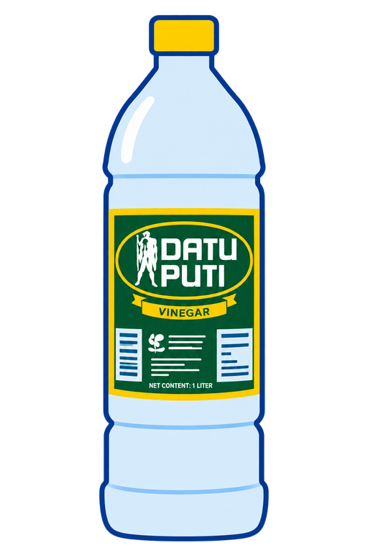

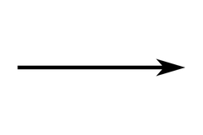

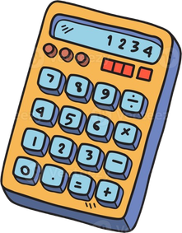


ATOM COUNT CARD
Datu Puti: Calculating acetic acid within a vinegar
PRODUCT IDENTITY
BASE QUANTITATIVE DATA
PRODUCT
• Datu Puti, Vinegar 1L
COMPOUND
• Acetic acid, CH₃COOH (molecular formula C₂H₄O₂).
WHY IT MATTERS
• Acetic acid is the main component of vinegar apart from water, and it gives vinegar its sour taste and pungent smell.
STUDENT
• Rey Ivan B. Guevara (Chemistry For Engineers).
QUANTITY
VALUE
SOURCE
PRECISION
Net content
1L
Product label
Nominal, Not Limiting
Concentration
4.5% w/w
Kibbutz Online Grocery & Cooperative Store, n.d.
2 s.f (limiting)
Density
0.987 g/mL
Evangelista et al., 2012
3 s.f
Atomic masses C,H,O
12.011, 1.008, 15.999 g/mol
CIAAW (2024)
Not limiting
Avogadro constant, N
A
6.022 140 76 × 10²³ mol⁻¹
BIPM (2019)
Exact
Formula C2H4O2
Subscripts 2,4,2
PubChem (NCBI, n.d.)
Exact counts
Assumptions: Acidity (4.5 %) comes from a retailer’s description read as w/w, while the printed standardized label for it says its 5% research says its a rounded value; Temperature not reported.
MOLAR MASS BUILD-UP
1000
mL solution
THE MOLE MAP: 1L bottle
Element
ATOMS
g/mol (each)
g/mol
% by mass
45
mL AcOH
÷60.052
0.7
mol AcOH
C
2
12.011
24.022
40.002
x4.5/100
x0.987 g/mL
4.4415 x 101
H
4
1.008
4.032
6.714
g AcOH
O
2
15.999
31.998
53.284
1.7 x 1024
molecules C2H4O2
xNA
C2H4O2
8
60.052
100.000
Exacted from mL solution to mL AcOH, rounded from g AcOH up to the final process
x4 H atoms per molecules
4.2 x 1023
molecules C2H4O2
ADDITION RULE: each contribution has 3 decimal places
Molar mass of C2H4O2
MOLE CONVERSION CALCULATIONS
Percent composition + two-route check (hydrogen)
2(12.011) + 4(1.008) + 2(15.999) = 60.052 g/mol
Label bridge: volume → mass of AcOH
%H =
4.032 g/mol
x 10000% = 6.714%
4.5 mL AcOH
0.987 g
60.052 g/mol
1000 mL sol x
100 mL sol
= 45 mL AcOH x
1 mL AcOH
Route A: 44.415 g x 0.06714 = 2.982 g
= 44.415 g
= 4.4415 x 101 g AcOH
Route B: 0.7396 mol AcOH x
4 mol H
= 2.9584 mol H
2.9584 mol H x
1.008 g
1 mol AcOH
Mass → moles
1 mol H
= 2.982 g
44.415 g x
1 mol
= 0.7396 mol = 7.4 x 10-1 mol AcOH
Both routes → 2.9 x 100 g H ✔️
60.052 g
Reverse: from % composition to the formula
Moles → molecules
In 1000g: C 40.002 ÷ 12.011 = 3.3304 mol; H 6.714 ÷ 1.008 = 6.6607 mol; O 53.284 ÷ 15.999 = 3.3305 mol
0.7396 mol x
NA molecules
= 4.4540 x 1024
÷ 3.3305 → 2.000 : 4.000 : 2000 → C2H4O2
1 mol
= 4.5 x 1024 molecules
Reverse: how much solution in one mole?
Atoms of one element inside the formula
1.00 mol x
60.052 g
x
1 mL AcOH
x
100 mL soln
= 1352.07 mL
4.4540 x 1024 molecules x
4 H atoms
1 mol
0.987 g
4.5 mL AcOH
1 molecule
= 1.7816 x 1025
→ 1.3 x 103 mL solution
= 1.8 x 1025 H atoms
In % composition of hydrogen atoms 10000% was used as an equivalent of 100
ONE BOTTLE
SCALE-UP: FROM ONE BOTTLE TO A RESTAURANT
ONE RESTAURANT, ONE YEAR
ONE HUNDRED RESTAURANT, ONE YEAR
REVERSE
1000 mL of 4.5% solution
Assuming the restaurant consumes 50 bottles/year
For 100 restaurants averaging the same per year
One mole of AcOH is in
0.7 mol AcOH
3.7 x 101 mol
3.7 x 103 mol
1.3 x 103 mL
4.2 x 1023 molecules
50 x 0.7396 mol
= 36.98 mol = 2.2 kg AcOH
5000 x 0.7396 mol = 3698 mol = 222 kg AcOH
of solution, almost ⅓ more than the bottle
SIGNIFICANT-FIGURE
ONE-NUMBER TAKEAWAY
• 1000 mL - Ambiguous
• 4.5% - 2 s.f (numbers taken from source only contained 2 digits)
• 0.7 mol - 2 s.f {rounded}
calculator = 0.7396090055 mol
• (% by mass values)
40.052 ; 6,714 ; 53.284 {rounded to 3 s.f decimal points}
calculator:
40.00199827
6.714181043
53.28382069
• 2.9 x 100
• 1.3 x 103 mL - 2 s.f {rounded}
One whole 1 L bottle of Datu Puti holds about 4.5 × 10²³ molecules of acetic acid, which is still less than one mole, meaning it would take about 1.3 × 10³ mL of vinegar to collect just 6.022 × 10²³, which is simply a mole of acetic acid and yet acetic acid remains as the main component of a vinegar.
AI DISCLOSURE
The specific AI used for this exercise are Claude and ChatGPT wherein ChatGPT was used merely to generate the vinegar image and Claude was used for citaitions and scan them for information needed before the actual calculation and it was also used to select the acetic acid compound which has similar properties to the compound example of the exercise criteria and instruction files.
CITATIONS
•National Center for Biotechnology Information. (n.d.). PubChem compound summary for CID 176, acetic acid. Retrieved October [day], 2026, from PubChem. (2019). Acetic acid. Nih.Gov; PubChem. https://pubchem.ncbi.nlm.nih.gov/compound/Acetic-acid
•Evangelista, D. K. O., Gotuato, G. B., Ocbina, J. B., & Padua, J. A. H. (2012). Determination of total acidity of vinegar [Unpublished laboratory report]. Philippine Normal University. Studylib. File. (2016, March 10). Studylib.Net. https://studylib.net/doc/9584923/file
•Bureau International des Poids et Mesures. (2019). The International System of Units (SI) (9th ed.). SI brochure - BIPM. (2026). BIPM. https://www.bipm.org/en/publications/si-brochure
•Kibbutz Online Grocery & Cooperative Store. (n.d.). Datu Puti vinegar 1 liter. Kibbutz. Retrieved October 17, 2026, from https://kibbutz.ph/product/datu-puti-vinegar-1-liter/
Most result values in this atom count card infographic are rounded to utmost 4 decimal points

